Slide 1
IE 411/511:
Visual Programming for Industrial Applications
Lecture Notes #3
Introduction to Visual Basic
Programming

Slide 2
Module Learning Objectives
In this module, the following topics will be covered
Writing simple Visual Basic programs
Using the Windows Forms designer to position, size and align controls
Writing statements that input data from the user and display results to the user
Declaring and using data of various types
Using variables to store data for later use in a program
Using arithmetic operators to perform calculations

Slide 3
Module Learning Objectives (cont.)
Using the precedence of arithmetic operators to determine the order in which operators are applied
Writing decision-making statements
Using equality and relational operators to compare operands
Applying basic principles of interface design
  Visual Hierarchy
  Visual Flow
  Gestalt Principles

Slide 4
Introduction (cont.)
In Visual Basic, graphical user interfaces (GUIs) are built using controls that are sometimes called components or widgets (short for window gadgets)
GUI controls are objects that can display information on the screen or enable users to interact with an app via
  The mouse
  Keyboard or
  Other forms of input (such as voice commands)
The .NET framework provides many predefined controls
Consistent user interfaces enable a user to learn new applications faster because the applications have the same look-and-feel

Slide 5
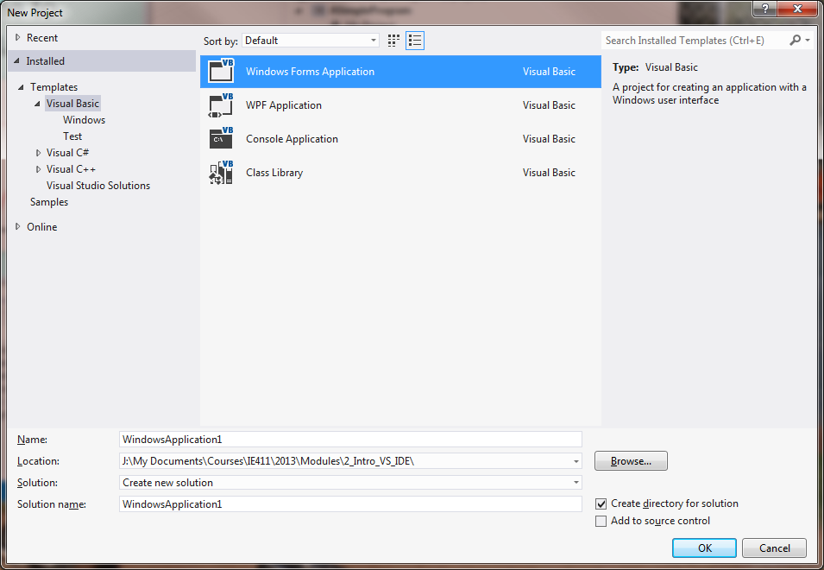
Introduction (cont.)
In this course, GUIs will be developed using Windows Forms Applications (or projects)

Slide 6
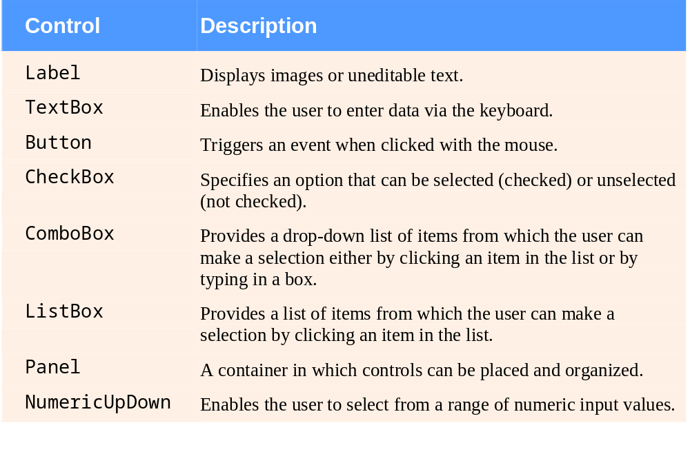
Introduction (cont.)
Most typical GUI controls used with Windows Forms applications

Slide 7
Introduction (cont.)
In the previous module, a simple GUI app using visual programming was created
The app’s appearance was defined by dragging and dropping GUI controls onto a Form
  Properties were set in design mode
  No code was written
The app displayed text and an image, but it did not perform any other actions
However, apps will generally be built with a combination of
  Visual programming, and
  Conventional programming techniques

Slide 8
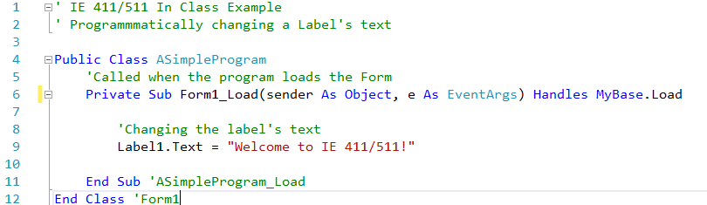
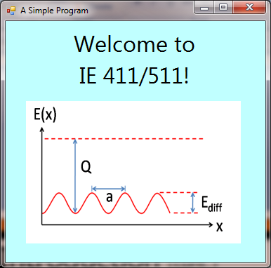
Simple Visual Basic (VB) Program

Slide 9
Analyzing the Simple VB Program
A single-quote character (') starts a comment
  Comments improve code readability
  Types of comments
  The Visual Basic compiler ignores comments

Slide 10
Analyzing the Simple VB Program (cont.)
Classes
Windows Forms apps consist of pieces called classes
  Logical groupings of methods and data that simplify program organization
Methods perform tasks and can return information when the tasks are completed
Every Windows Forms app consists of at least one class that typically contains methods that perform tasks

Slide 11
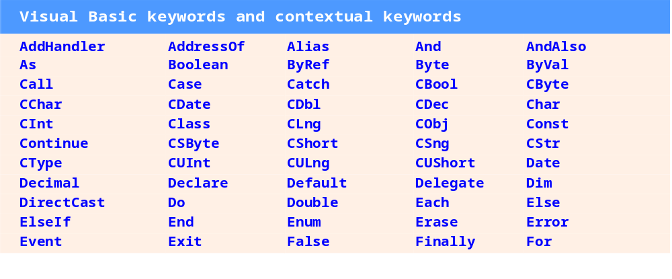
Analyzing the Simple VB Program (cont.)
Keywords
The words Public and Class are examples of keywords
  Words reserved for use by Visual Basic

Slide 12
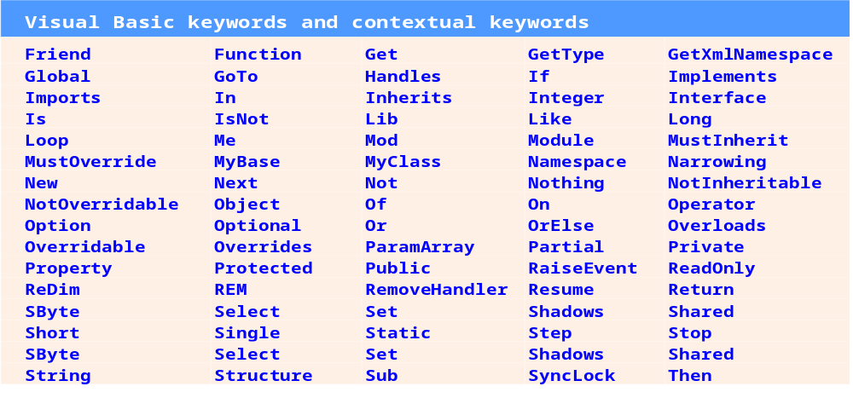
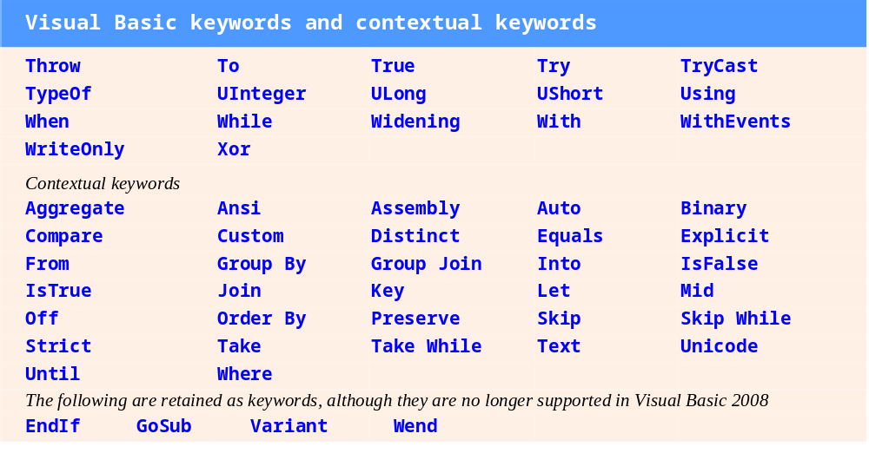
Analyzing the Simple VB Program (cont.)

Slide 13
Analyzing the Simple VB Program (cont.)
Class Name and Identifiers
The name of the Class (i.e., ASimpleProgram) is an identifier
  A series of characters consisting of letters, digits and underscores (_)
Identifiers cannot begin with a digit and cannot contain spaces
  Examples of valid identifiers are:
  Examples of invalid identifiers are:

Slide 14
Analyzing the Simple VB Program (cont.)
Keywords and identifiers are not case sensitive
As a good programming practice, use whitespace characters to enhance program readability
  Blank lines
  Spaces
  Tabs

Slide 15
Analyzing the Simple VB Program (cont.)
The Form’s Load Event and Method Form1_Load
GUIs are event driven
When the user interacts with a GUI component, the interaction causes the program to perform a task by “calling” a method
  These interactions are called events
Common events include
  Clicking a Button
  Selecting an item from a menu
  Closing a window
  Moving the mouse
All GUI controls, including Forms, have events associated with them

Slide 16
Analyzing the Simple VB Program (cont.)
A method that performs a task in response to an event is called an event handler
  The process of responding to events is known as event handling
Most of a GUI app’s functionality executes based on events
Event handling methods are called automatically

Slide 17
Analyzing the Simple VB Program (cont.)
Defining a Method
The keyword Sub begins the method declaration
  The code that will be executed by this method
  The keywords End Sub close the method declaration
  The body of the method declaration appears between the lines of code containing the keywords Sub and End Sub
The keyword Sub is short for subroutine
Methods are also sometimes called procedures

Slide 18
Analyzing the Simple VB Program (cont.)
Indentation
Certain lines are indented relative to other in the simple VB program
  Indentation improves program readability
  For example, it makes it clear that method Form1_Load is part of the class Form1
The indentation is whitespace and is ignored by the compiler
In Visual Basic, the IDE indents the statements in a method’s body for you

Slide 19

Analyzing the Simple VB Program (cont.)
Modifying a Label’s Text with Code
The code below does the “real work” in the program
The second line instructs the computer to perform an action
  i.e., change the text on Label1 to the characters contained between the double quotation marks
The entire line is called a statement
  The characters Welcome to IE 411/511! and the surrounding double quotes are called string literals or simply strings

Slide 20
Analyzing the Simple VB Program (cont.)
Modifying a Label’s Text with Code
The statement uses the assignment operator (=) to give the Text property a new value
The statement is read as “Label1.Text gets the value “Welcome to IE 411/511!””
The expression Label1.Text contains two identifiers separated by the dot separator (.)
  The identifier to the right of the dot separator is the property name
  The identifier to the left of the dot separator is the name of the Label control

Slide 21
Analyzing the Simple VB Program (cont.)
Syntax Shading
The code coloring scheme used by the IDE is called syntax-color highlighting
  It helps to visually differentiate program elements
Keywords appear in dark blue
Comments are colored green
Strings are colored brown
Other program elements use different colors

Slide 22
In Class Exercise
Modifying the Simple VB Program
Open the VB program developed in the previous module
Make the following modifications:
  Change the name of the Form to ASimpleProgram
  Create an event handler for the Form_Load method
  Write code to change the text in Label1 to “Welcome to IE 411/511!” when the Form loads
  Add full-line and end-of-line comments to your program

Slide 23
Analyzing the Simple VB Program (cont.)
Sometimes statements may be too long
  An example is the line that starts with Public Sub
To improve readability, long statements may be split over several lines
  In earlier versions of Visual Basic, you had to use the line-continuation character (_) to do this as follows
    Private Sub ASimpleApp_Load(sender As Object, _
    e As EventArgs) Handles MyBase.Load
Line-continuation characters are not required
  However, they are good practice if you want your programs to be readable

Slide 24
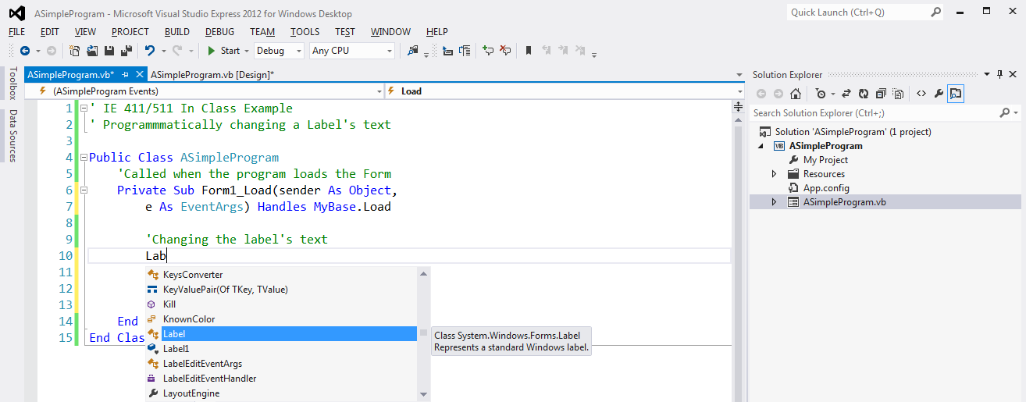
Analyzing the Simple VB Program (cont.)
Writing Code and Using IntelliSense
As you begin typing code in Visual Basic, a small window appears
This IDE feature is called IntelliSense
  It lists keywords, class names, members of a class (which include property and method names) and other features that start with the same characters that have been typed so far

Slide 25
Analyzing the Simple VB Program (cont.)
Writing Code and Using IntelliSense (cont.)
As you type characters, IntelliSense highlights the first item that matches the characters typed so far
  It then displays a tool tip containing information about that item
You can type the complete item name or you can let the IDE insert the complete name for you
  Either by double clicking the item’s name in the list or by pressing the <Space> or <Tab> keys
When the complete name is provided, the IntelliSense window closes

Slide 26
Analyzing the Simple VB Program (cont.)
Writing Code and Using IntelliSense (cont.)
After the dot (.) is typed after Label1, the IntelliSense window shows only the members of class Label that can be used on the right side of the dot
  This helps in learning about the control or class being used
While the IntelliSense window is displayed, pressing the <Ctrl> key makes the window transparent
Also, if IntelliSense is accidentally closed (normally by pressing the <Esc> key), it can be displayed at any time by pressing <Ctrl> and the <Spacebar>

Slide 27
Analyzing the Simple VB Program (cont.)
Compiling and Running the Program
Select DEBUG > Start Debugging
  Or press <F5> or the toolbar button
The IDE first compiles the program as it is run
You can also compile the program without running it by selecting BUILD > Rebuild Solution
  This creates a new file with the project’s name and the .exe file-name extension
  The .exe file extension indicates that the file is executable
  This file executes on the .NET Framework

Slide 28
Analyzing the Simple VB Program (cont.)
Syntax Compilation Errors, Error Messages, and the Error List Window
Go back to the app in the IDE
When a line of code is typed followed by the <Enter> key, the IDE responds either by applying syntax-color highlighting or by generating an error
When an error occurs, the IDE places a red squiggle below the error and provides a description of the error in the Error List window

Slide 29
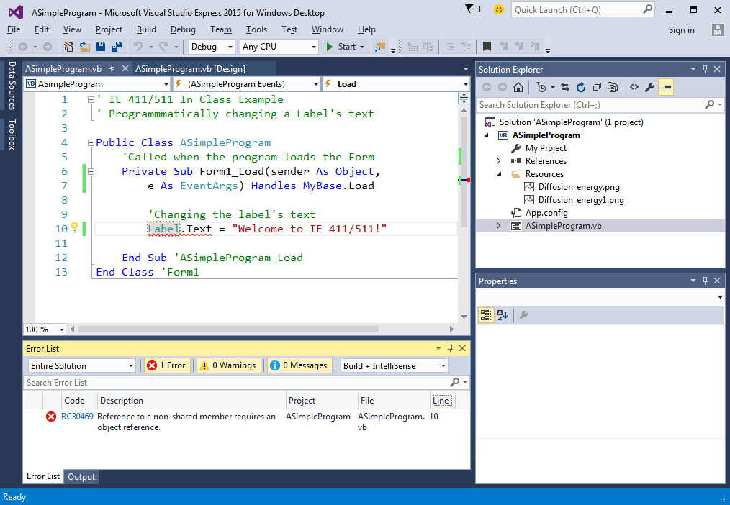
Analyzing the Simple VB Program (cont.)
Syntax Compilation Errors, Error Messages and the Error List Window

Slide 30
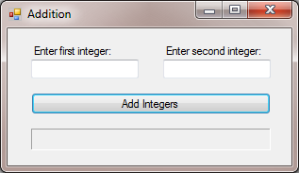
First Solution in VSE 2015
The Addition Solution

Slide 31
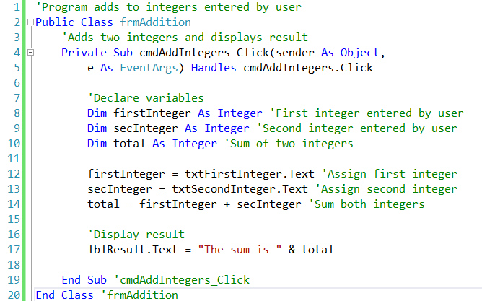
First Solution in VSE 2015 (cont.)
Finished Code for Addition Solution

Slide 32
First Solution in VSE 2015 (cont.)
Variable Declarations and Naming
Lines 8–10 are variable declarations
  Begin with the keyword Dim
The words firstInteger, secInteger and total are identifiers for variables
  Locations in the computer’s memory where values can be stored for use by a program
All variables must be declared before they can be used

Slide 33
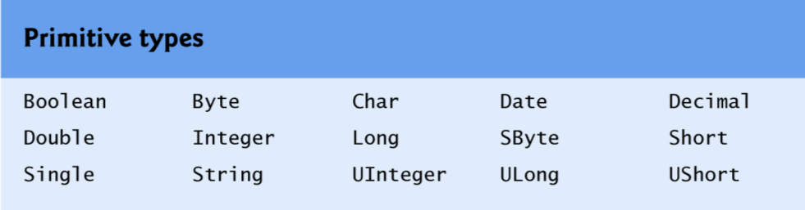
First Solution in VSE 2015 (cont.)
Variable Declarations and Naming
The declarations in lines 8–10 specify that the variables firstInteger, secInteger and total are data of type Integer
  Whole numbers such as 919, –11, 0 and 138624
Types defined as part of the Visual Basic language, such as Integer, are known as primitive types and their type names are keywords

Slide 34
First Solution in VSE 2015 (cont.)
Variable Declarations and Naming
The justification for the many different data types is the trade off among
  Calculation requirements
    A variable is needed to store the total number of seconds in a 24-hr period. What data type should be used?
    Variable type definition should be planned carefully so that program execution errors are avoided
  Memory requirements
    Variable data types that use more bytes (1 byte = 8 bits) require more computer memory
  Processing time requirements
    VBA processes double-precision numbers more efficiently than single-precision numbers

Slide 35
First Solution in VSE 2015 (cont.)
Variable Declarations and Naming
A variable name can be any valid identifier
Variables of the same type can be declared in separate statements or in one statement with each variable in the declaration separated by a comma
  The latter format uses a comma-separated list of variable names
You should choose meaningful variable names to make your programs “self-documenting”
  This helps other people understand your code

Slide 36
First Solution in VSE 2015 (cont.)
Using Variables to Store Values
Line 12 uses an assignment operator (=) to give a value to variable firstInteger
  The statement is read as “firstInteger gets the value returned by txtFirstInteger.Text”
We call the entire statement an assignment statement because it assigns a value to a variable
The txtFirstInteger.Text gets the value that the user typed in the TextBox

Slide 37
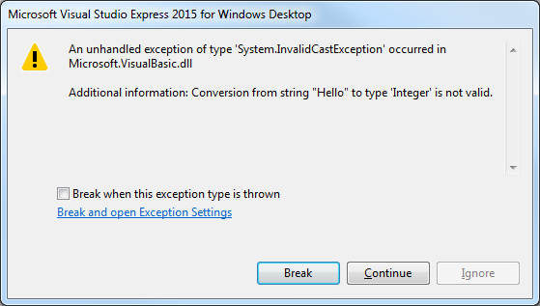
First Solution in VSE 2015 (cont.)
Data Type Error
What if the user does not enter an Integer?
  For this program, if the user types a non-integer value (e.g., “hello”) a runtime error (i.e., an error that has its effect at execution time) occurs

Slide 38
First Solution in VSE 2015 (cont.)
Using Variables in a Calculation
The assignment statement in line 14 calculates the sum of the Integer variables firstInteger and secInteger and assigns the result to variable total
The statement is read as “total gets the value of firstInteger + secInteger”
  The expression to the right of the = is always evaluated first before the assignment occurs
The addition (+) operator is called a binary operator, because it has two operands
  firstInteger and secInteger

Slide 39
First Solution in VSE 2015 (cont.)
Displaying the Result
Line 17 displays the result of adding the two values by assigning a new value to the Text property of the label lblResult
The expression "The sum is " & total
  Uses the string concatenation operator (&) to combine the string literals
The string concatenation operator is a binary operator that joins two strings together, resulting in a new, longer string
  If one of the operands is a number, the program automatically creates a string representation of the number

Slide 40
First Solution in VSE 2015 (cont.)
In Class Exercise
Addition Solution

Slide 41
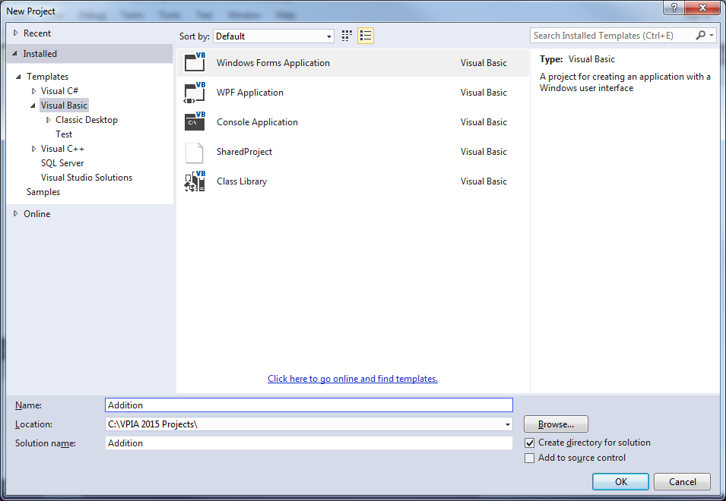
First Solution in VSE 2015 (cont.)
Start VSE 2015
Select New Project... to display the New Project dialog
  Choose Windows Forms Application
  For Name, enter “Addition”, then click OK
  Choose a location for your solution with the Browse… button

Slide 42
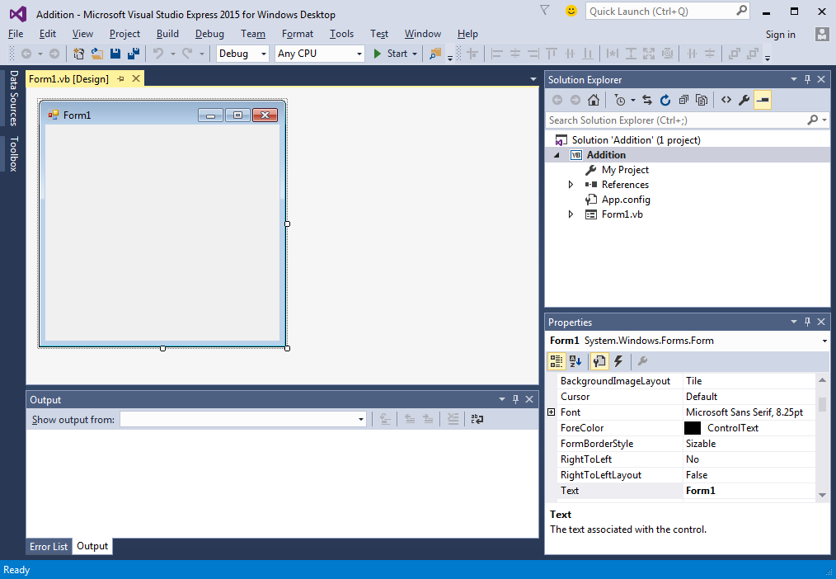
First Solution in VSE 2015 (cont.)
The IDE now display an empty Windows Form control

Slide 43
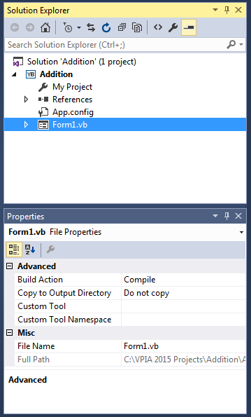
First Solution in VSE 2015 (cont.)
Click Form1.vb in the Solution Explorer window to display its properties
Change the File Name to frmAddition.vb
Answer “Yes” to the question about renaming all references
Solution Explorer
Click Form1.vb to display its properties
Properties window
File Name property

Slide 44
First Solution in VSE 2015 (cont.)
Layout the controls in the form
Use the naming convention shown below

Slide 45
First Solution in VSE 2015 (cont.)
Good Programming Practices
A Label used to describe the purpose of a control should use sentence-style capitalization and end with a colon
Place each descriptive Label either above or to the left of the control that it identifies
  Align the bottoms of a group of descriptive labels if they are arranged horizontally
  Align the left or right sides is they are arranged vertically
The text of a Button should use book-title capitalization
  Text should be concise and meaningful to the user

Slide 46
First Solution in VSE 2015 (cont.)
Good Programming Practices
Place controls that display output below and/or to the right of input controls on a Form
Set the BorderStyle property of output labels to Fixed3D to distinguish then from descriptive labels
If a single statement must be split across line, choose breaking points that make sense
  After a comma (in a comma-separated list)
  After an operator in a lengthy expression
If a statement is split across two or more lines, indent all subsequent lines with one level of indentation

Slide 47
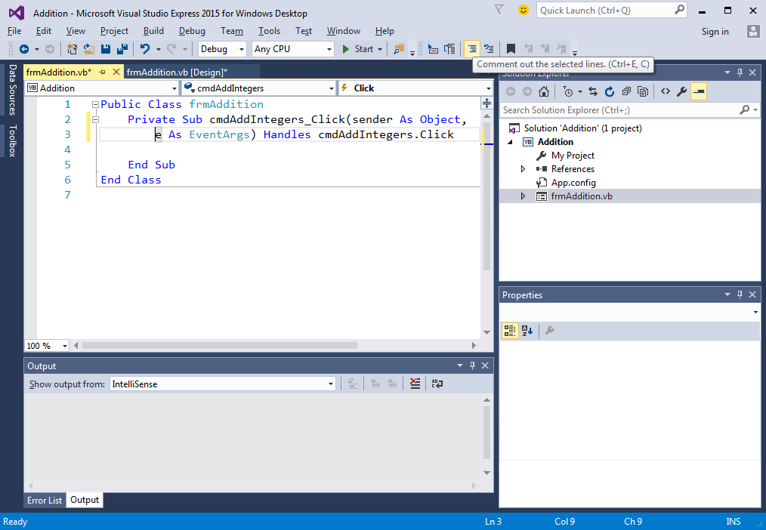
First Solution in VSE 2015 (cont.)
Double-click on the command Button to create an event handler
  cmdAddIntegers_Click
The IDE now displays an empty editor window
  The code coloring scheme used by the IDE is called syntax-color highlighting
Empty editor window. You type your code here

Slide 48
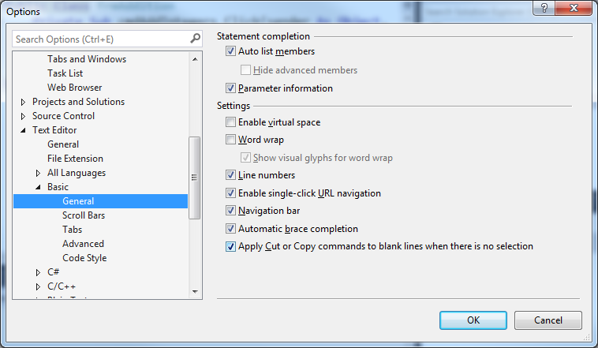
First Solution in VSE 2015 (cont.)
To add line numbers to the editor, select Tools > Options….
  Expand the Text Editor category
  Expand the Basic category
  Select General
  Check the Line Numbers check box

Slide 49
First Solution in VSE 2015 (cont.)
Entering Code
Enter the necessary code in the event handler to
  Read the numbers
  Perform the calculation, and
  Display the final result
To ensure that your line numbers match with those shown in slide 31, make sure to
  Enter the full-line comments in lines 1, 3, 7, and 16
  Split the first line of the Click method definition as shown in lines 4–5

Slide 50
First Solution in VSE 2015 (cont.)
Testing the Solution
When all the code has been entered, test the program to ensure that it works correctly
  Enter 45 for the first number and 72 for the second, then click the “Add Integers” button
  The result should be 117
When testing programs, use values that result in known results to simplify the process
  Starting with extreme values is always helpful

Slide 51
Memory Concepts
Variable names correspond to locations in memory
Every variable has a name, type, size and value
Input data is placed into a memory location to which the name number1 has been assigned

Slide 52

Memory Concepts (cont.)
Whenever a value is placed in a memory location, this value replaces the value previously stored in that location
Suppose that the user enters 72 when prompted for number2
number2 = txtSecondInteger.Text
The Integer value 72 is placed into location number2, and memory appears as follows

Slide 53

Memory Concepts (cont.)
The program adds number1 and number2 and
places their total into variable total
total = number1 + number2
After total is calculated, memory appears as follows
The values of number1 and number2 appear exactly as they did before the calculation

Slide 54
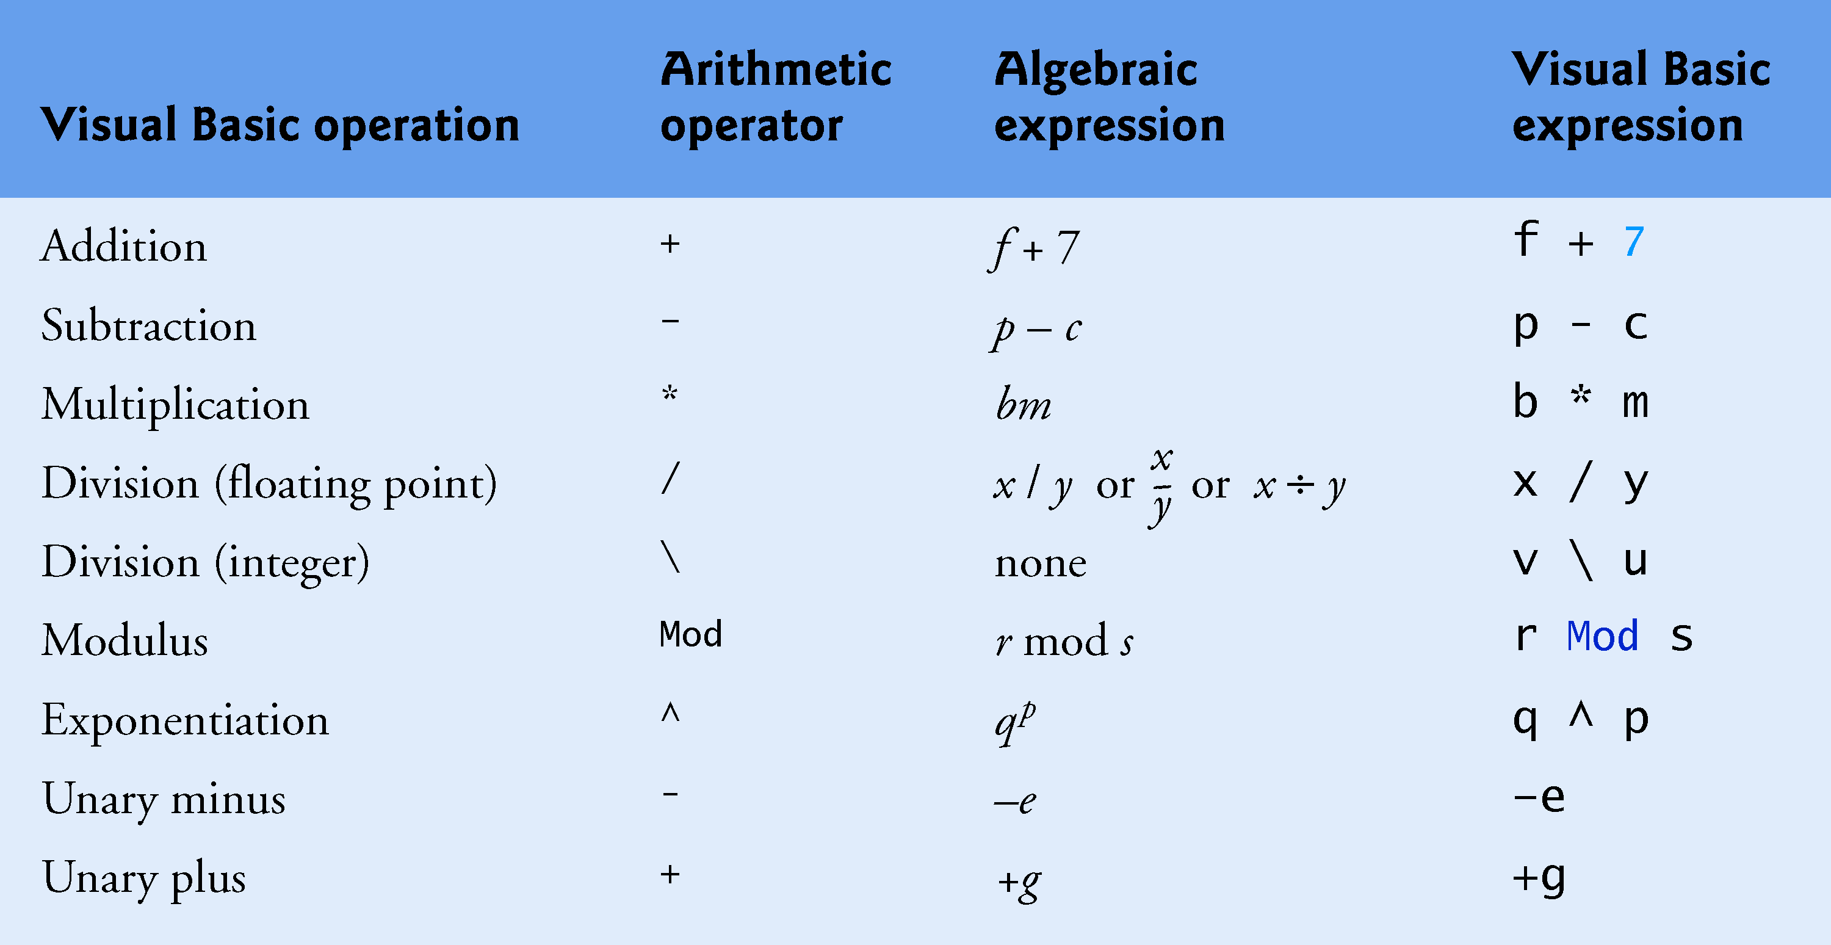
Arithmetic
Arithmetic operators are summarized below
Some of the symbols are not used in algebra

Slide 55

Arithmetic (cont.)
Integer division takes two Integer operands and yields an Integer result
  Floating-point number operands are rounded to the nearest whole number
  Any fractional part in the result is discarded (not rounded)
The Mod operator yields the remainder after division
Expressions such as must be written as a/b
to appear in a straight line
Using the integer division operator (\) when the floating-point division operator (/) is expected can lead to incorrect results
  Ensure that each integer division operator has
  only integer operands

Slide 56
Arithmetic (cont.)
Most of the arithmetic operators are binary operators
  Each operates on two operands
  For example, the expression sum + value contains the binary operator + and the two operands sum and value
Visual Basic also provides unary operators that take only one operand
  For example, unary versions of plus (+) and minus (–) are provided, so that you can write expressions such as +9 and –19

Slide 57
Arithmetic (cont.)
Mod Operator
The Mod operator yields the remainder after division
The expression x Mod y yields the remainder after x is divided by y
  7 Mod 4 = 3
  17 Mod 5 = 2
You use this operator mostly with Integer operands, but it also can be used with other types

Slide 58
Arithmetic (cont.)
Rules of Operator Precedence
Operators in arithmetic expressions are applied in a precise sequence determined by the rules of operator precedence
  See next slide
  Rules are similar to those in algebra
Operators in the same row of the table have the same level of precedence
When we say operators are evaluated from left to right, we are referring to the operators’ associativity
  All binary operators associate from left to right

Slide 59
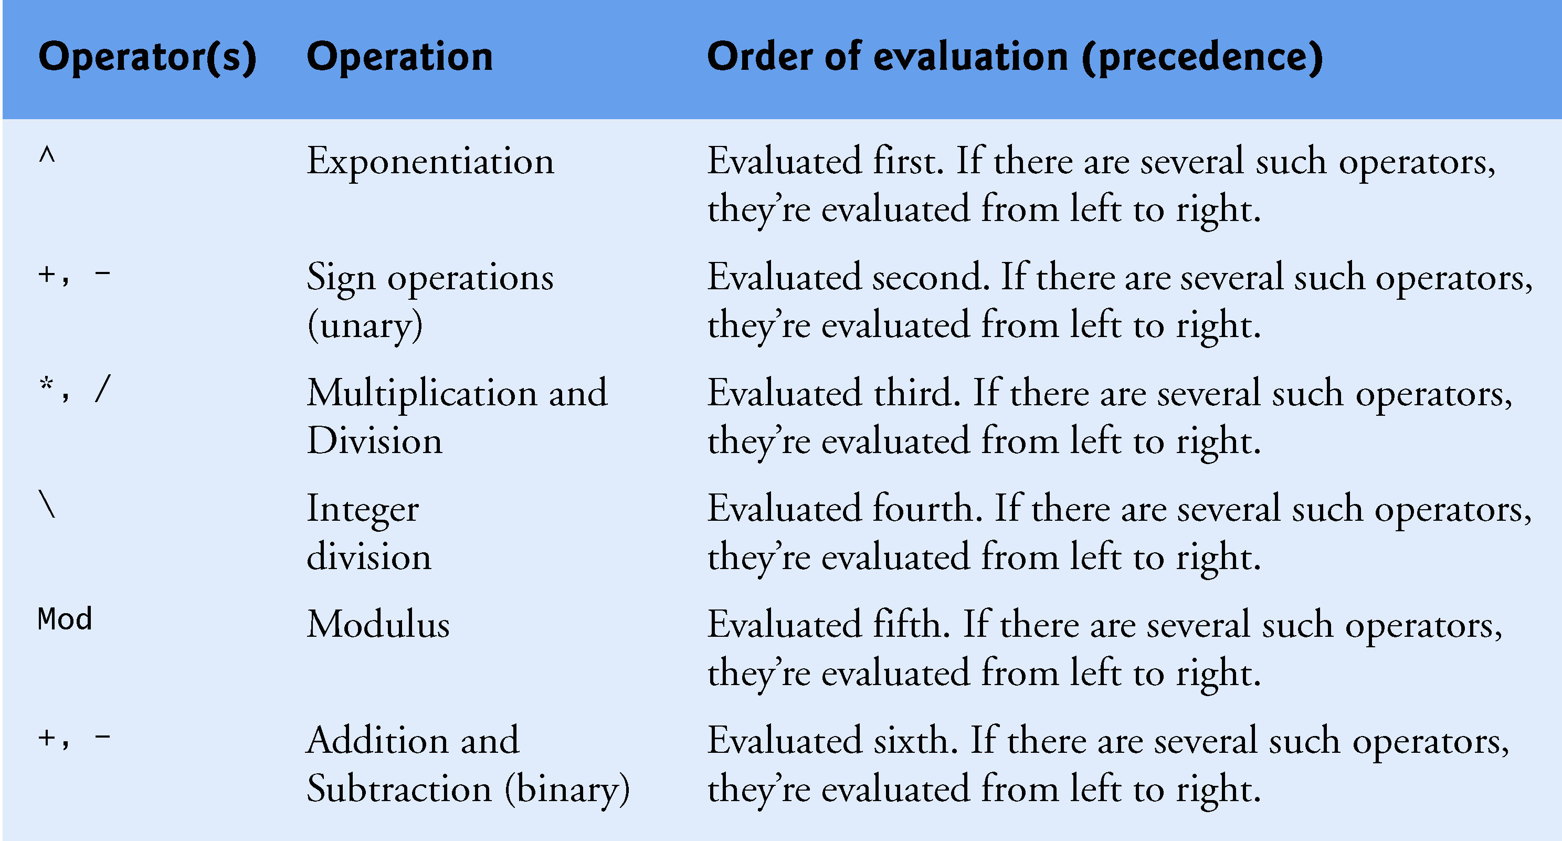
Arithmetic (cont.)
Precedence of Arithmetic Operators

Slide 60
Arithmetic (cont.)
Consider several expressions with the rules of operator precedence:
Algebra:
How should we write this in Visual Basic?
a + b + c + d + e
m =
5

Slide 61
Arithmetic (cont.)
The following is the equation of a straight line:
Algebra → y = mx + b
Visual Basic? →

Slide 62
Arithmetic (cont.)
Consider the following expression
Show how the expression will be written in Visual Basic and the order in which the operations are executed

Slide 63
Arithmetic (cont.)
Consider how y = ax² + bx + c is written and evaluated
Evaluate the expression using the following values
  a = 2, b = 3, c = 7, x = 2

Slide 64
Arithmetic (cont.)
As a good programming practice, use redundant parentheses to make complex expressions easier to read
Also, you can use parentheses to force the order when you are uncertain about the order of evaluation in a complex expression
  Just as you would in an algebraic expression
  Doing so can help avoid subtle bugs

Slide 65
Equality and Relational Operators
The If...Then statement allows a program to make a decision based on the truth or falsity of a condition
  If the condition is met, the statement in the If...Then statement’s body executes
  Conditions can be formed by using equality operators and relational operators
The relational and equality operators all have the same level of precedence and associate from left to right

Slide 66
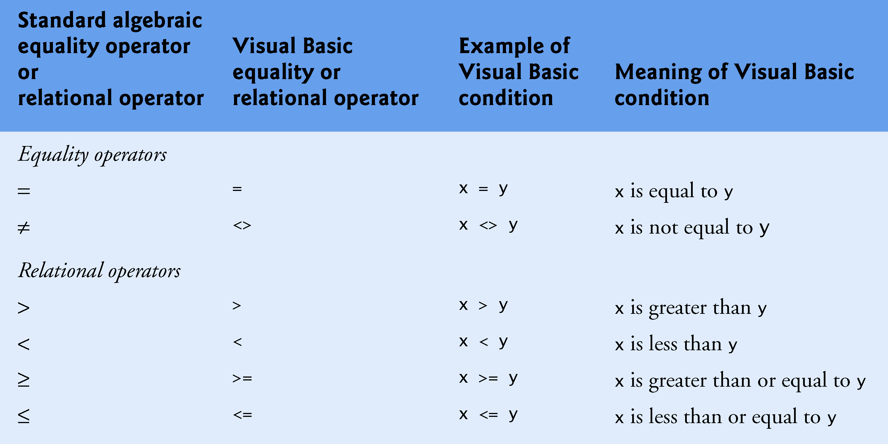
Equality and Relational Operators (cont.)
List of equality and relational operators used in Visual Basic
It is a syntax error to reverse the symbols in the operators <>, >= and <= (as in ><, =>, =<)
  The Visual Basic IDE fixes these errors as you type

Slide 67
Comparisons with Operators
Visual Basic indents the statements in the body of an If…Then statement to emphasize the body statements and enhance program readability
You should also follow this convention when programming in other languages

Slide 68
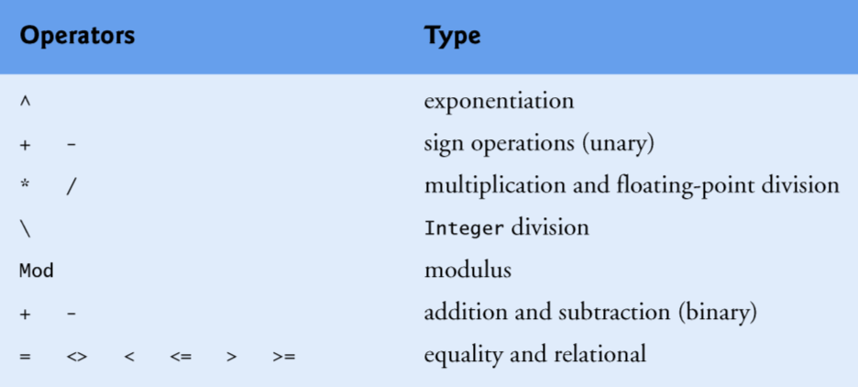
Comparisons with Operators (cont.)
Operators displayed in decreasing order of precedence

Slide 69
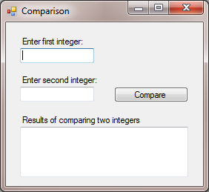
Comparisons with Operators (cont.)
Comparing Two Numbers Solution

Slide 70
Comparisons with Operators (cont.)
Comparing Integers with the Equality and Relational Operators
The Comparison program uses six If…Then statements to compare two numbers you enter
If the condition in any of these statements is true, the statement associated with that If…Then executes
The values you enter are stored in variables number1 and number2, respectively
Then the comparisons are performed and the results are displayed in a multiline TextBox

Slide 71
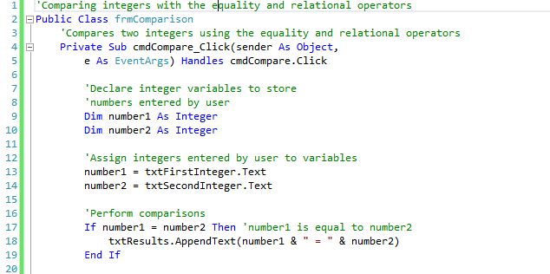
Comparisons with Operators (cont.)
Comparing Two Numbers Solution Code

Slide 72

Comparisons with Operators (cont.)
Comparing Two Numbers Solution Code

Slide 73
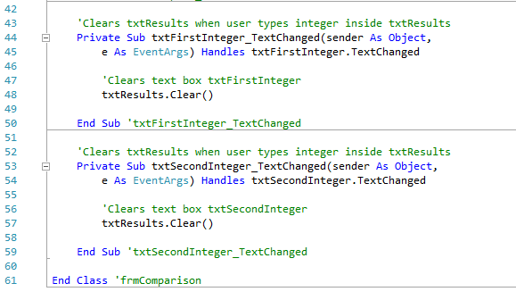
Comparisons with Operators (cont.)
Comparing Two Numbers Solution Code

Slide 74
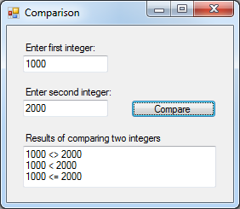
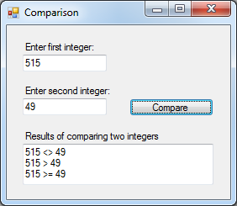
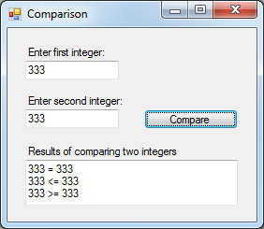
Comparisons with Operators (cont.)
Comparing Two Numbers GUI

Slide 75
Comparisons with Operators (cont.)
Getting the Values Entered By the User
Lines 9–10 declare the variables that are used in the cmdCompare_Click event handler
  The comment that precedes the declarations indicates the purpose of the variables in the program
Lines 13–14 get the numbers that the user entered and assign the values to Integer variables number1 and number2, respectively

Slide 76
Comparisons with Operators (cont.)
Displaying Text in a Multiline TextBox
In this program, we display several lines of text in a TextBox
To enable this functionality, we set the TextBox’s MultiLine property to True in the Properties window
We also use the TextBox’s AppendText method
  Enables us to add more text to what is already displayed in a TextBox

Slide 77
Comparisons with Operators (cont.)
The statement in line 18 is known as a method call
  Calls the method AppendText of class TextBox to perform its task
Sometimes you give a method values known as arguments that the method uses while performing its task
  In line 18 the expression “number1 & " = " & number2” in parentheses is the argument to method AppendText
Lines 26, 30, 34, and 38 also append the value vbNewLine to the TextBox
  vbNewLine is a predefined value known as a constant
  Positions the output cursor at the beginning of the next line in the TextBox

Slide 78
Comparisons with Operators (cont.)
Handling the TextChanged Events
If the user wishes to compare different values and starts typing in txtFirstInteger or txtSecondInteger, the previous results will still be displayed in the txtResults
  This can be confusing to the program’s user
To prevent this problem, you can handle txtFirstInteger ’s and txtSecondInteger’s TextChanged events and use them to clear the contents of the txtResults

Slide 79
Comparisons with Operators (cont.)
Handling the TextChanged Events
The TextChanged event is a TextBox’s default event
  This method is called when the user types in the corresponding TextBox
In both cases, we call the txtResults’s Clear method
  Removes the text that is currently displayed in the TextBox
  You can also clear a Label’s or TextBox’s Text property by assigning it the value String.Empty

Slide 80
Comparisons with Operators (cont.)
Build and test the Comparing Two Numbers solution
  Name controls as shown below
frmComparison
lblFirstInteger
txtFirstInteger
cmdCompare
lblSecondInteger
txtSecondInteger
lblResult
txtResult

Slide 81
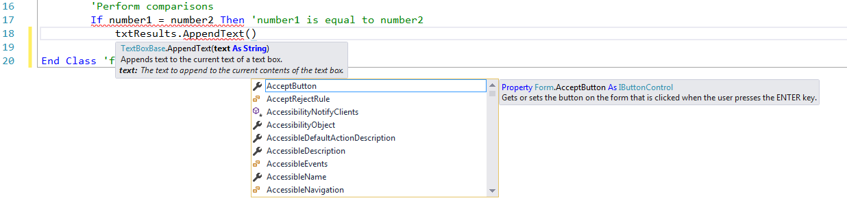
Comparisons with Operators (cont.)
The Parameter Info Window
After you type the left parenthesis character in line 18, the IDE displays the Parameter Info window
The Parameter Info window displays information about the method and the arguments that the method needs to perform its task

Slide 82
Designing Interfaces
Material in this part of the module has been adapted from:
Tidwell, J (2011). Designing Interfaces (2nd Ed.). Sebastopol, CA: O’Reilly

Slide 83
Introduction
In the past, interface designers worked with a small toolbox
  Windows Style Guide
  Macintosh Human Interface Guidelines
Today, a much bigger palette of components and ideas exist
  Java toolkits
  HTML/CSS
  JavaScript
  Flash
  Numerous open source options
However, it is still not easy to design good interfaces
  Expectations from users are higher than they used to be

Slide 84

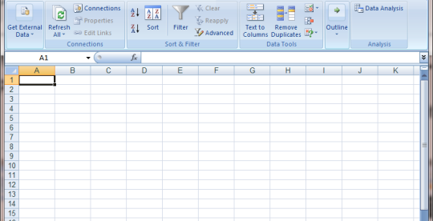
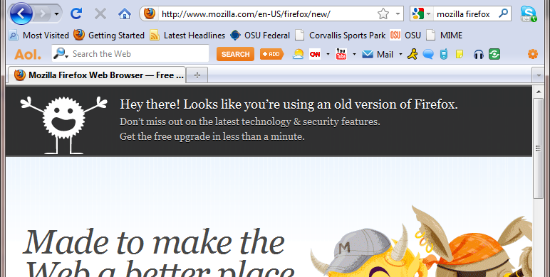
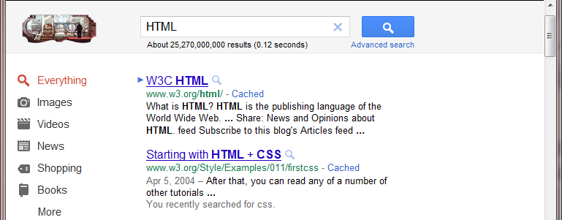
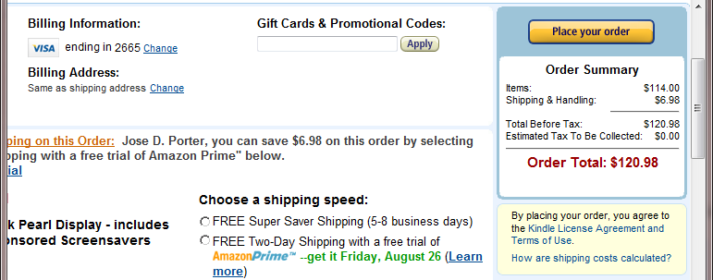
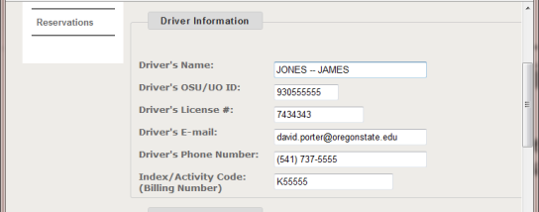
Introduction (cont.)
Two big effects on the craft of interface design
  Proliferation of interface idioms
    Recognizable types or styles of interfaces, each with its own vocabulary of objects, actions, and visuals
  Loosening of the rules for putting together interfaces from these idioms
    Not rare to see several idioms mixed up in a single interface
Text Editors
Spreadsheets
Browsers
Web Pages
E-commerce Sites
Forms

Slide 85
Designing Interfaces
What characterizes interfaces that are easy to use?
  The applications that are easy to use are designed to be familiar
Familiar does not mean that everything about a given application is identical to some genre-defining product
  e.g., Word, Photoshop, Mac OS
As long as the parts are
  Recognizable enough
  Relationships among the parts are clear
Then people can apply their previous knowledge to a novel interface and figure it out

Slide 86
Designing Interfaces (cont.)
This is where patterns come in
Patterns are structural and behavioral features that improve the habitability of something
  User interface
  Website
  Object-oriented program
  Building
Patterns can be a description of best practices within a given design domain

Slide 87
Characteristics of Patterns
Concrete, not general
Valid across different platforms and systems
Products, not processes
Suggestions, not requirements
Relationships among elements, not single elements
Customized to each design context

Slide 88
User Interface Design Process
When doing design, a sound process is critical
These are some elements that help in the design process
  Field research
  Goal and task analysis
  Design models
  Empirical testing
  Enough time to iterate over several versions

Slide 89
What Users Do
Good interface design starts with an understanding of people
  What they are like
  Why they use a given piece of software
  How they might interact with it
There is a maxim in the field of interface design when it comes to users
The first step in designing an interface is to figure out what its users are really trying to accomplish

Slide 90
What Users Do (cont.)
Everyone who uses a tool – software or otherwise – has a reason for using it
Group discussion
  What are some of the reasons why you use a software tool?

Slide 91
Layout of Page Elements
Page layout is the art of manipulating the user’s attention on a page (or form) to convey
We will discuss several elements of page layout
  Visual hierarchy
  Visual flow

Slide 92
Layout of Page Elements (cont.)
Visual Hierarchy
Very simple concept
  The most important content should stand out the most, and the least important should stand out the least
  Layout components ought to look like what they are (e.g., titles, subtitles, lists, etc.)
  The user should be able to deduce the informational structure of the page from its layout
A good visual hierarchy gives instant clues about

Slide 93
Layout of Page Elements (cont.)
Visual Hierarchy
How do we make things look important?
Visual Basic
Visual Basic
Visual Basic

Slide 94
Layout of Page Elements (cont.)
Visual Hierarchy
How do we show relationships among form elements?

Slide 95
Layout of Page Elements (cont.)
Visual Flow
Deals with the tracks that the reader’s eyes tend to follow as they scan the page (or form)
Intimately related to visual hierarchy
  A well designed visual hierarchy sets up focal points on the form
  Visual flow leads the eyes from those into less important information
Several forces can work against each other when you try to setup a visual flow
  One is our tendency to read top to bottom and left to right

Slide 96
Layout of Page Elements (cont.)
Visual Flow
How do we create a good visual flow?

Slide 97
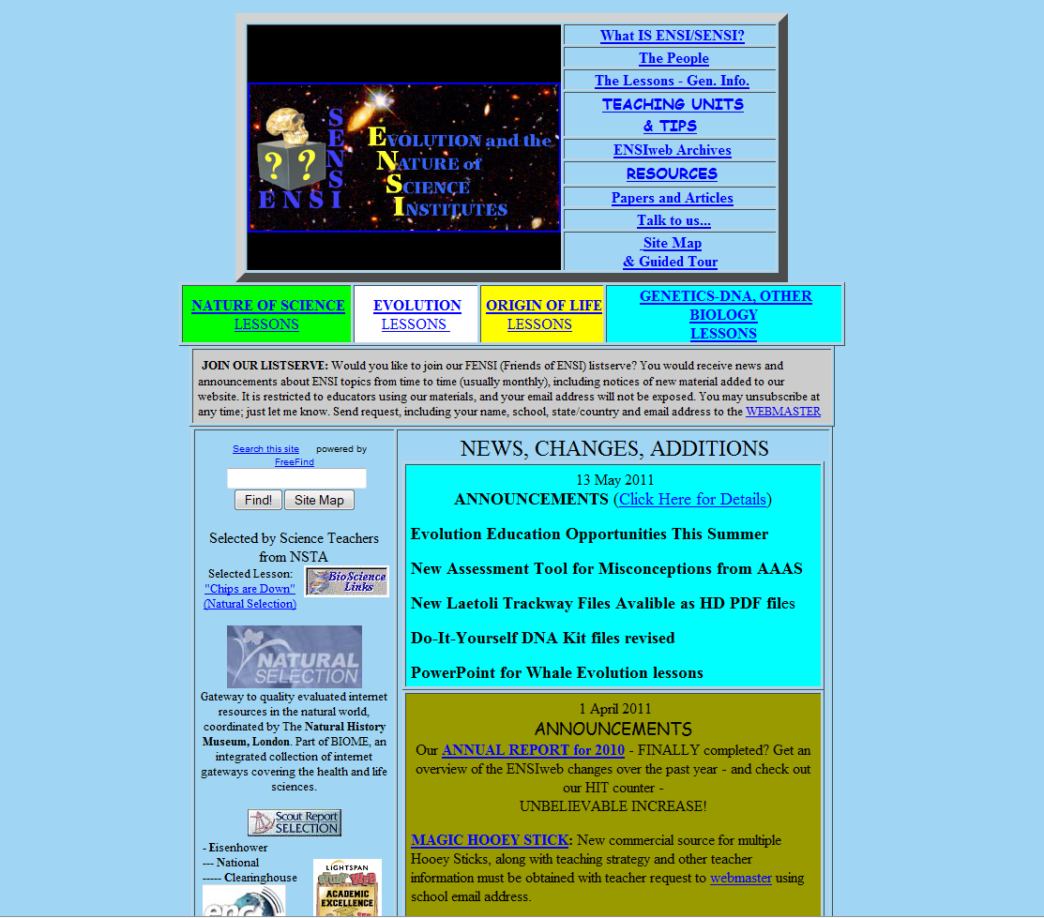
Layout of Page Elements (cont.)
Bad Visual Hierarchy and Visual Flow

Slide 98
Layout of Page Elements (cont.)
Theory behind grouping and alignment was developed early in the 20th century by the Gestalt psychologists
Gestalt means unified whole
  Refers to theories of visual perception developed by German phycologists in the 1920s
  Theories attempt to describe how people tend to organize visual elements into groups or unified wholes when certain principles are applied

Slide 99
Layout of Page Elements (cont.)
Four Gestalt principles
  Proximity
    Put things together and viewers will associate them with one another
    Basis for strong grouping of content and controls on a user interface
  Similarity
    Viewers will associate things with one another if they have the same shape, size, color or orientation
  Continuity
    Our eyes want to see continuous lines and curves formed by the alignment of smaller elements
  Closure
    We also want to see simple closed forms, such as rectangles
    Groups of things often appear to be closed forms

Slide 100
Layout of Page Elements (cont.)
Four Gestalt Principles

Slide 101
Actions and Commands
Actions and commands are the verbs of the interface
Common ways actions are rendered to the user
  Buttons
  Menu bars
  Pop-up menus, drop-down menus
  Toolbars
  Links
  Hover tools
Then there are invisible actions
  Double-clicking on items
  Keyboard actions
  Drag-and-drop
  Typed commands

Slide 102
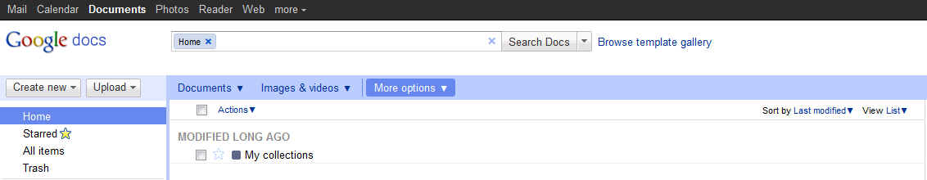
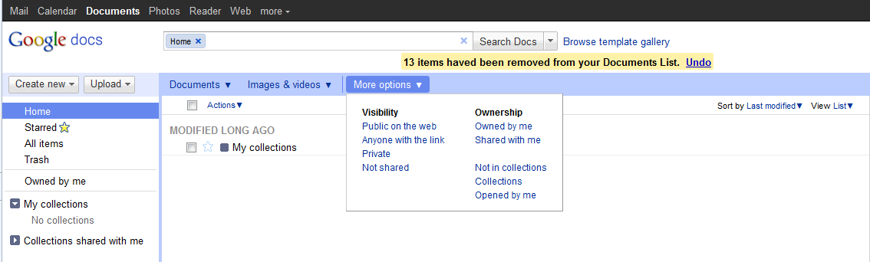
Actions and Commands (cont.)
Pattern → Button groups

Slide 103
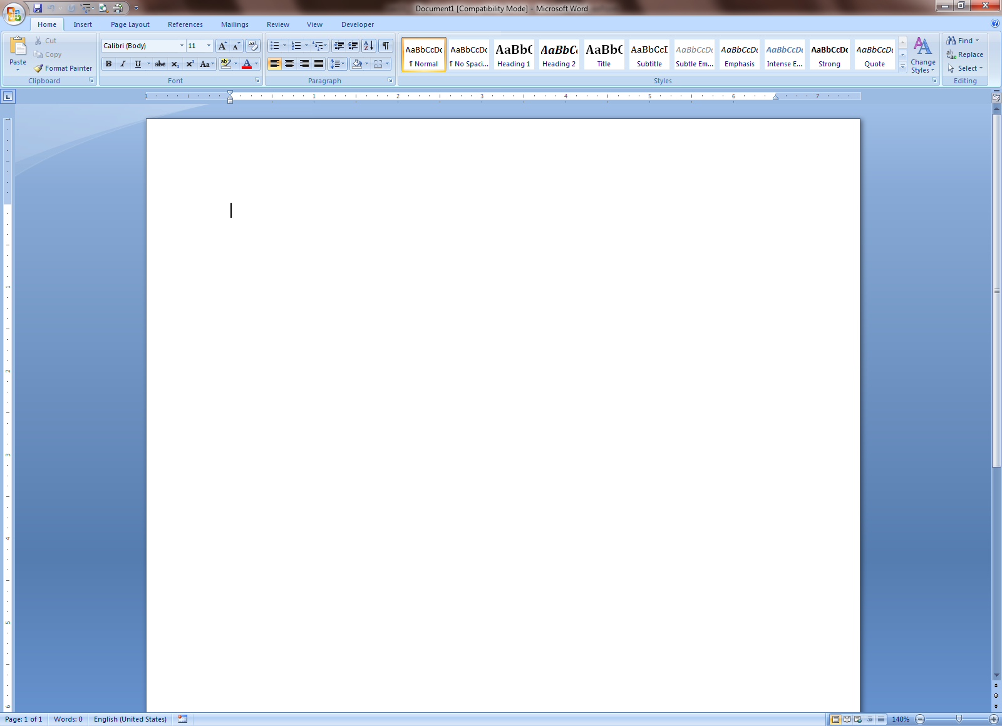
Actions and Commands (cont.)
Pattern → Button groups

